Slide 1
GROUP NO . 2
DATA SCIENCE PROJECT
BANKRUPTCY PREVENTION
PRESENTED BY -
VIKAS . P. RATHOD,
LEENA BHAVE,
MAHESH GURBAXANI,
ROHIT PAWAR,
Dheeraj U J

Slide 2
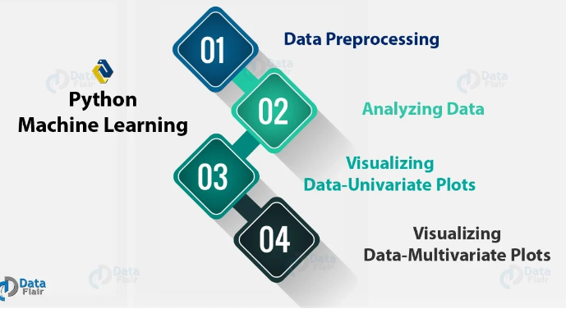
EXPLORATARY DATA ANALYSIS (EDA)
Exploratory Data Analysis (EDA) is an approach to analyzing data sets to summarize their main characteristics, often using statistical methods and graphical visualizations.

Slide 3
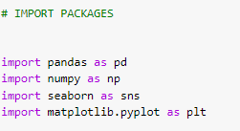

DATA PREPROCESSING
STEP 1 - IMPORT PYTHON LIBERARIES
STEP 2 - READING DATASET

Slide 4
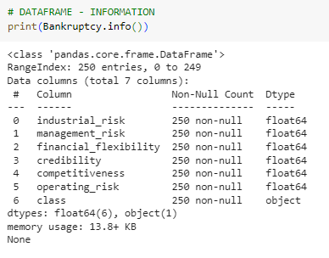
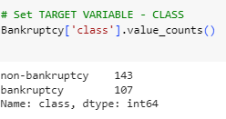
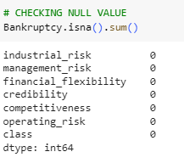
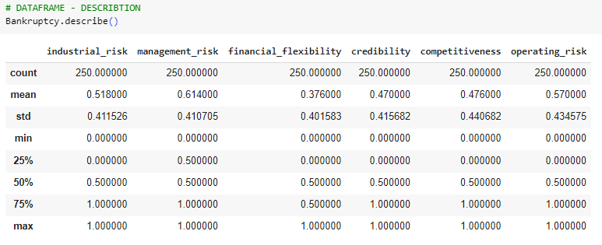

ANALYZING THE DATA
INFORMATION
COUNT
NULL VALUE
DESCRIPTION
SHAPE

Slide 5
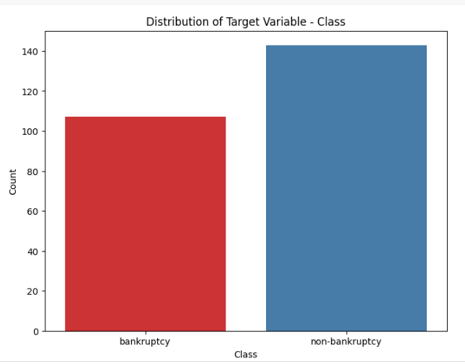
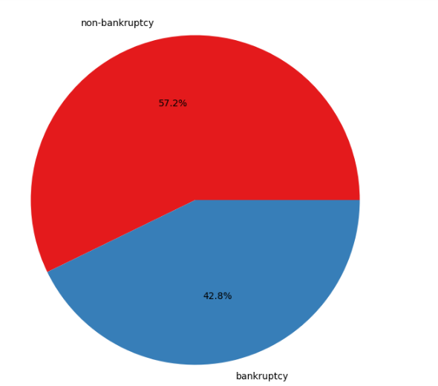
EDA UNIVARIATE ANALYSIS
COUNT PLOT
PIE CHART

Slide 6
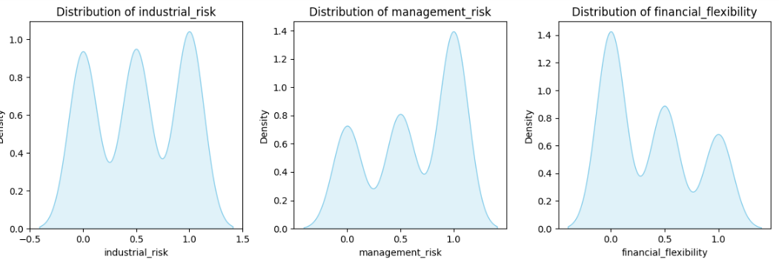
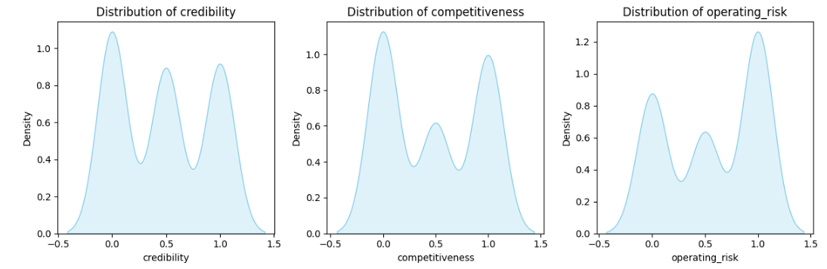
EDA BIVARIATE ANALYSIS
DENSITY PLOT

Slide 7
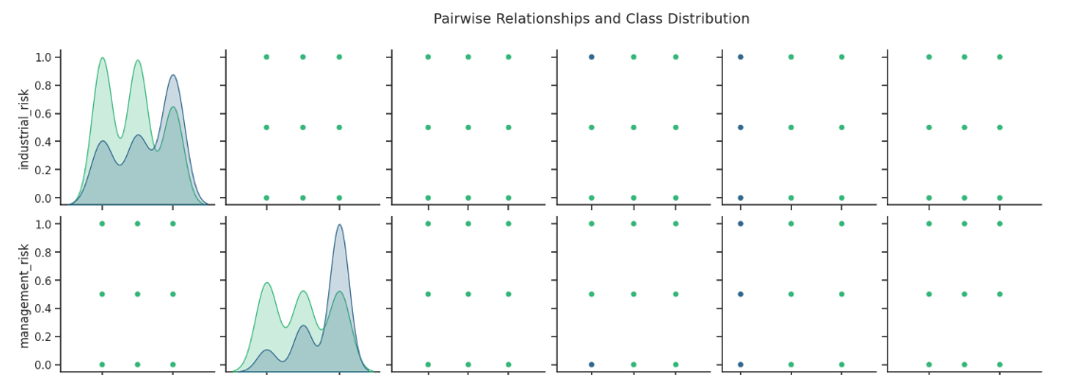
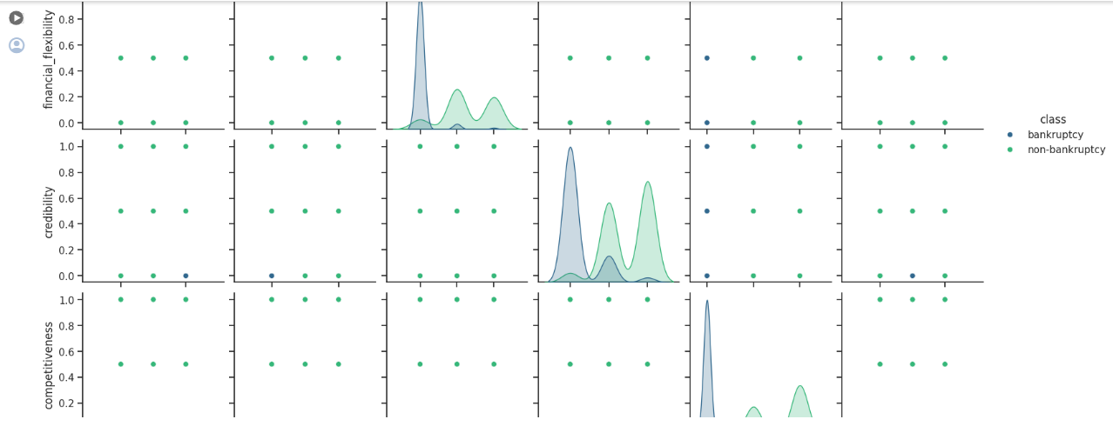
EDA BIVARIATE ANALYSIS
PAIRPLOT GRAPH

Slide 8
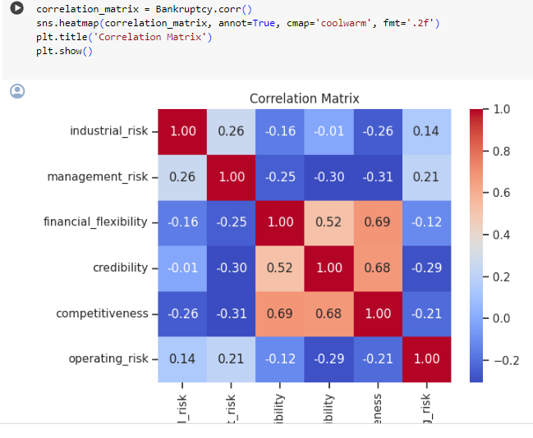
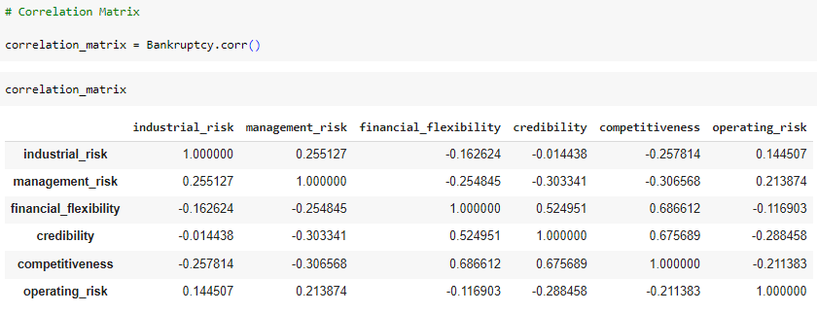
EDA MULTIVARIATE ANALYSIS
CORRELATION MATRIX

Slide 9
FIVE CLASSIFICATION MODELS WERE PREPARED:
LOGISTIC REGRESSION
RANDOM FOREST
NAIVE BAYES
DECISION TREE CLASSIFIER
SVM
THE FOLLOWING SLIDES WILL GIVE A SUMMARY OF EACH MODEL INDICATING THE FOLLOWING:
ROC CURVE
AREA UNDER THE ROC CURVE
F1 SCORES

Slide 10
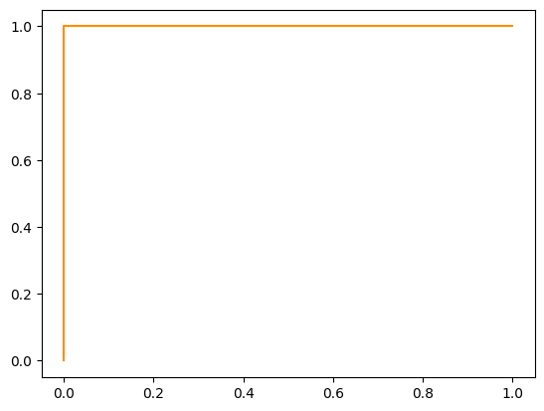
LOGISTIC REGRESSION
ROC CURVE
The f1 score is 1.0
AREA UNDER THE CURVE:1.0

Slide 11
RANDOM FOREST: ROC CURVE
F1 SCORE:1.0 AREA UNDER THE CURVE:1.0

Slide 12
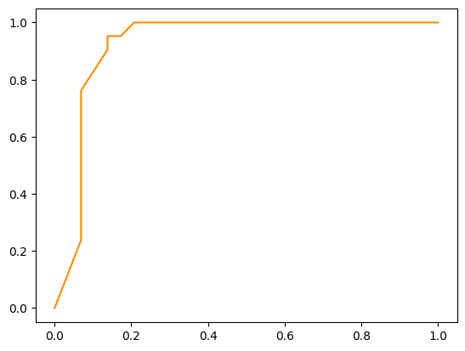
NAÏVE BAYES:ROC CURVE
F1 SCORE: 0.88 AREA UNDER THE CURVE:92.52%

Slide 13
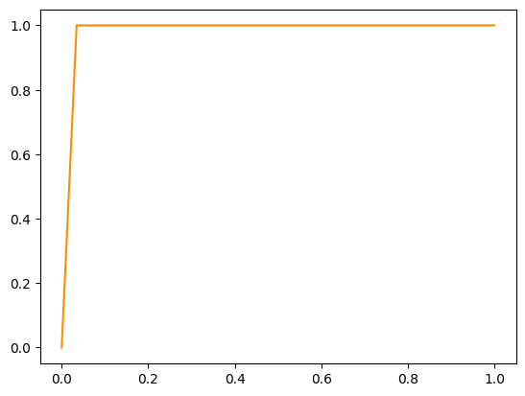
DECISION TREE CLASSIFIER: ROC CURVE
F1 SCORE:0.98 AREA UNDER THE CRVE:98.25%

Slide 14
SVM: ROC CURVE
F1 SCORE: 1.0 AREA UNDER THE CURVE:1.0

Slide 15
SUMMARY OF MODELWISE F1 VALUES
F1 VALUES
LOGISTIC REGRESSION 1.0
RANDOM FOREST 1.0
NAÏVE BAYES 0.88
DECISION TREE 0.98
SVM 1.0

Slide 16
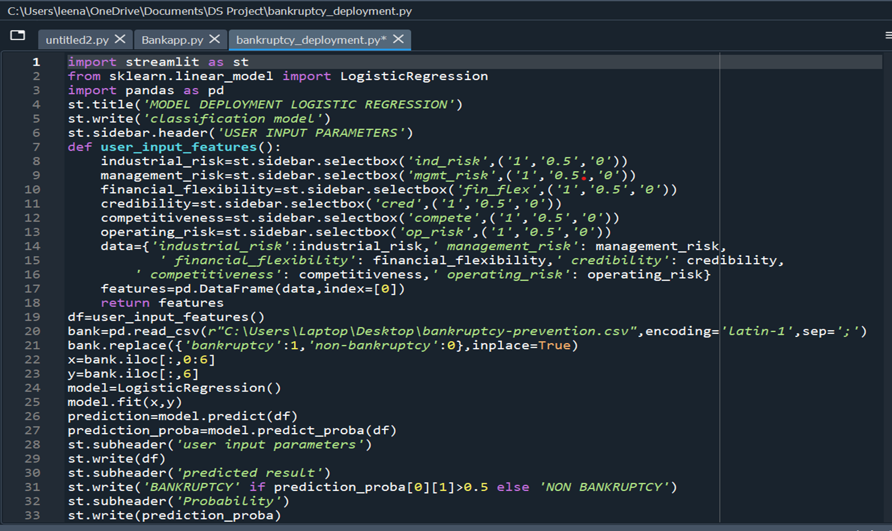

Slide 17
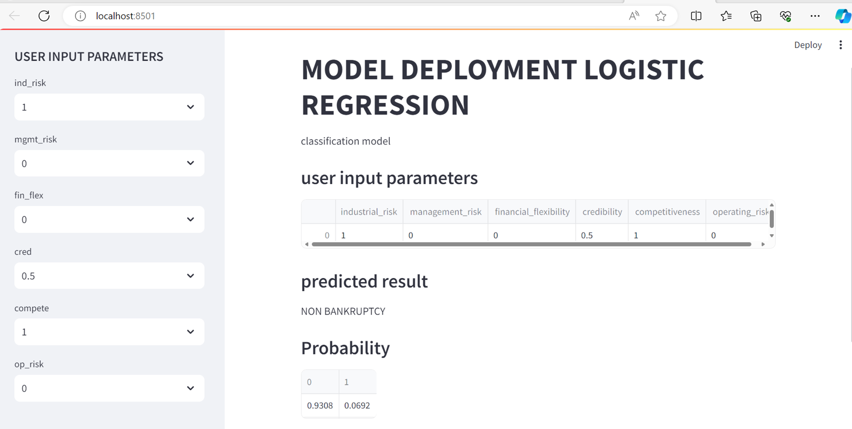

Slide 18
Thank You !

